Slide 1

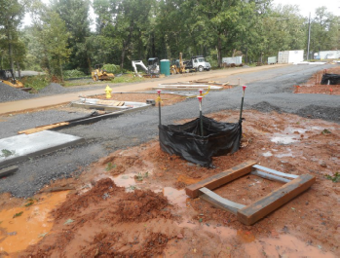
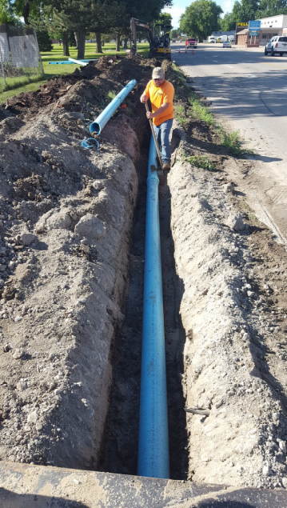
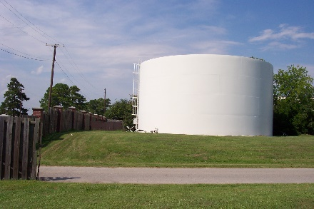
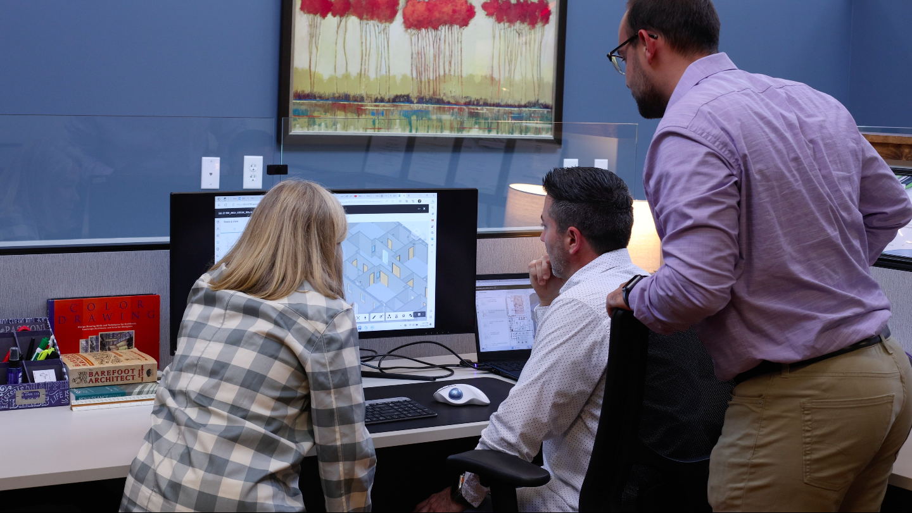
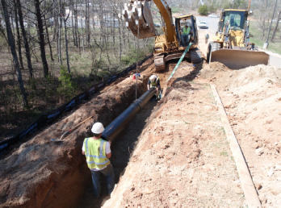
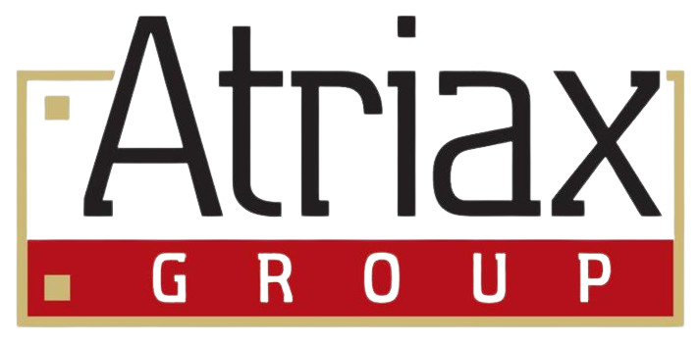
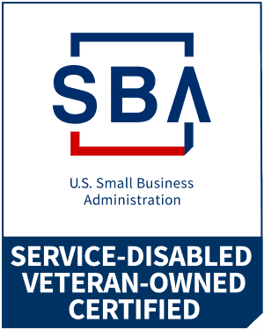
Atriax Support &
Investigative Services
Project programming &
Scope Development
Our Project Programming & Scope Development service helps clients define, refine, and optimize their project scope. Our specialized team guides clients through a structured process to clearly identify their needs, priorities, and goals while ensuring alignment with budgetary constraints.
Key Benefits:
Comprehensive Needs Assessment – We work closely with stakeholders to evaluate functional, operational, and aesthetic requirements.
Strategic Planning – Our team helps balance project aspirations with feasibility, ensuring a well-defined, actionable scope.
Budget Optimization – We provide expert guidance in aligning project goals with financial realities, identifying cost-saving opportunities without compromising quality.
Risk Mitigation – Early identification of potential challenges helps prevent costly revisions and delays.
Enhanced Decision-Making – Through workshops and data-driven analysis, we empower clients to make informed choices that enhance project success.
Streamlined Project Execution – A well-developed scope minimizes inefficiencies, accelerates timelines, and enhances coordination among all stakeholders.
To complement Atriax Group’s Architectural-Engineering & Construction services, we offer a comprehensive suite of solutions to support every stage of your project’s lifecycle. From initial site investigations to post-occupancy evaluations, our services help clients develop projects and programs, assess site conditions before design and construction, document physical progress, and analyze facility performance after completion.
These full-cycle services enhance project efficiency, provide valuable insights, and ensure better outcomes—strengthening your processes, capturing critical conditions, and improving both your current facility and future developments.
703 Main Ave SW
Hickory, North Carolina 28602
828-315-9962
www.atriaxgroup.com

Slide 2
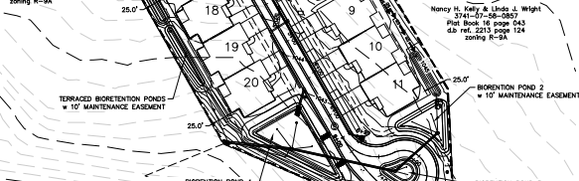
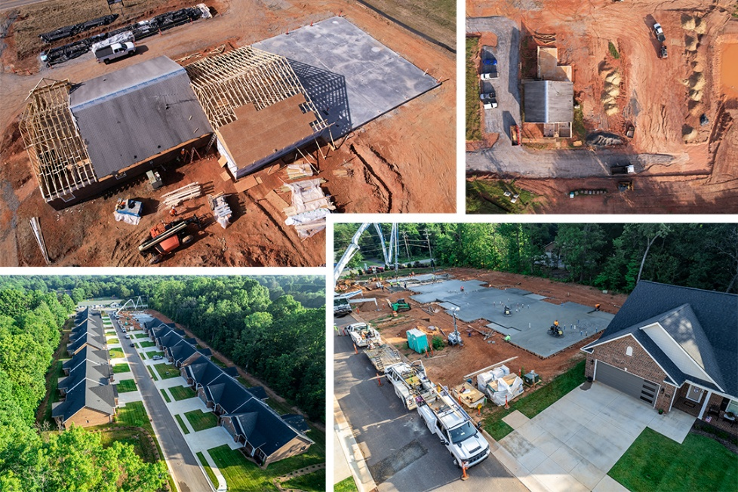
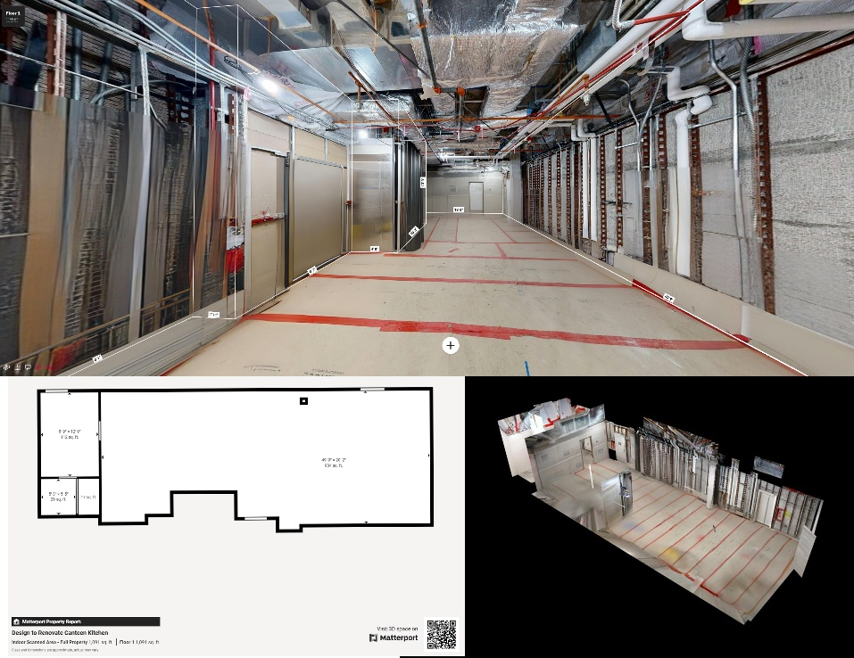
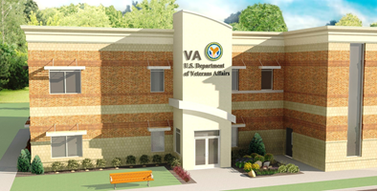
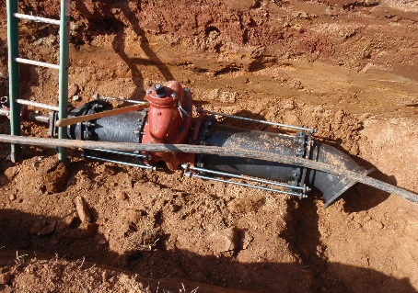
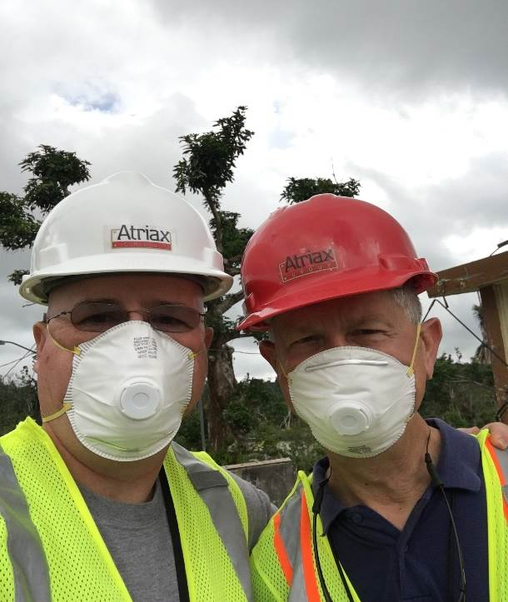
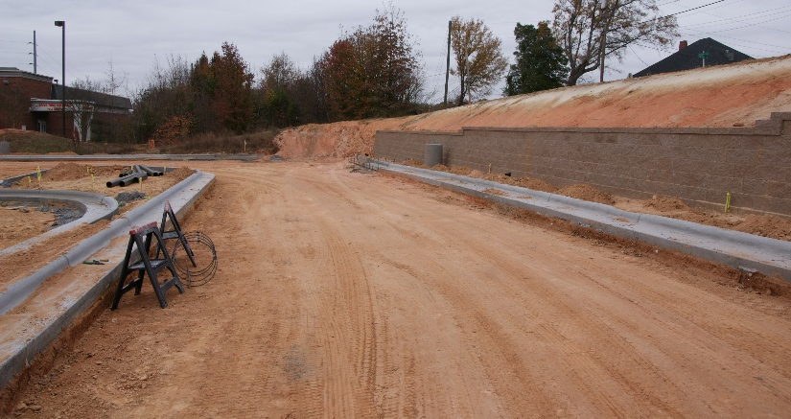
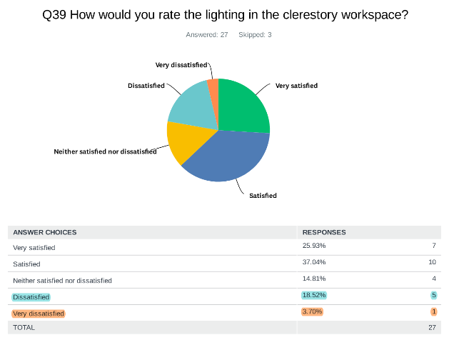
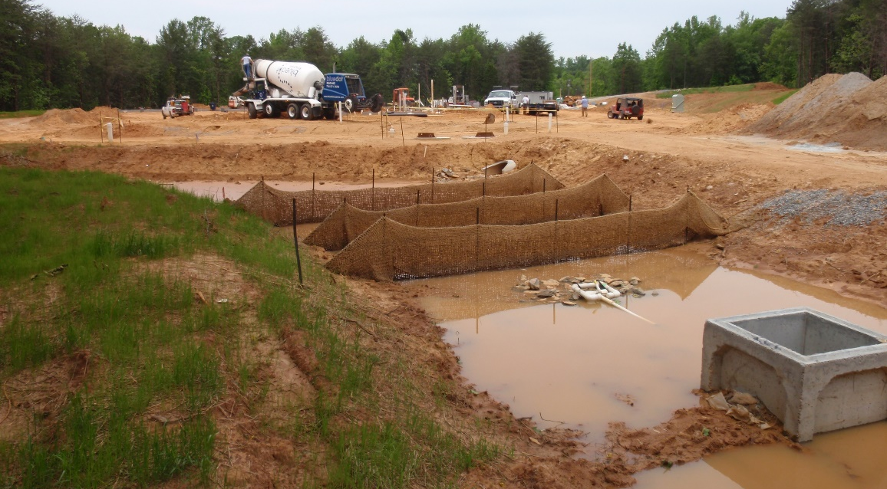
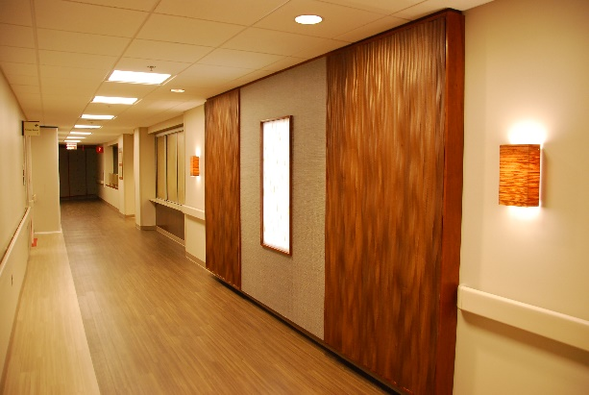
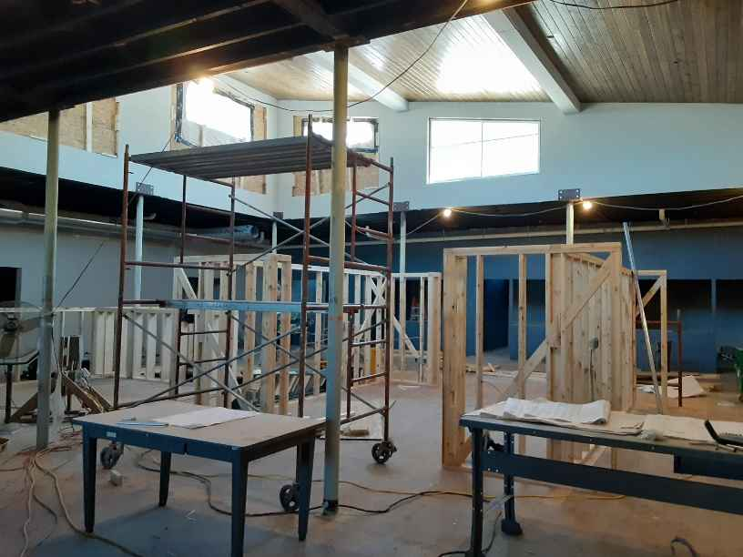
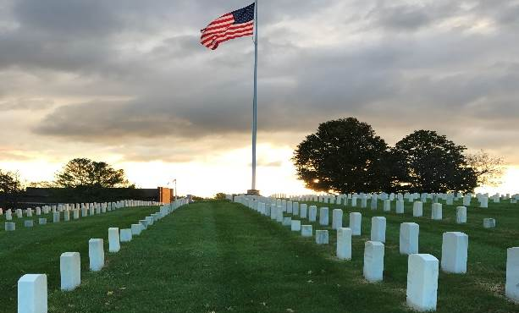
Unmanned Aircraft Systems Drones for aerial images, mapping and videography
At Atriax, we have the ability to utilize UAS (drone) technology for aerial imagery, site mapping and videography. During Construction, regular interval site scans are the best method to ensure and document proper materials, productivity and site management. These aerial images and videos also survey existing conditions of structures and are especially beneficial with capturing areas that are difficult to access. Our comprehensive photogrammetry processing can produce point-clouds, ortho-mosaic and 3D mapping with close to survey grade quality.
Atriax offers comprehensive interior and exterior LiDAR scanning services, ensuring precise surveying and documentation of existing conditions for design and construction projects. This advanced technology not only enhances accuracy and detail but also facilitates seamless data sharing with peers, consultants, and clients through a secure private portal. As a result, the need for additional site visits due to missed measurements or insufficient documentation is significantly reduced, if not eliminated, leading to cost savings and increased efficiency. By leveraging this cutting-edge technology, we distinguish ourselves through unparalleled accuracy, efficiency, and innovation in the industry.
From planning and design to specialty services, we’re ready to go when you are.
Light Detection and Ranging (LiDAR) Scanning Technology
CLIENTS
Federal Emergency Management Agency (FEMA)
US Department of Veterans Affairs – Veterans Administration
US Department of Veterans Affairs – Consolidated Mail Outpatient Pharmacy
US Department of Veterans Affairs – National Cemetery Administration
US Army Corps of Engineers
US Air Force
US Forest Service
Private, Commercial
PLANNING, DESIGN AND CONSULTATION
Verified Service Disabled Veteran-Owned Business
DUNS # 03-165-9431
CAGE Code 1XLUO
NAICS Codes
  541310 – Architectural Services
  541320 – Landscape Architectural Services
  541330 – Engineering Services
  541410 – Interior Design Services
  541611 – Administrative Management and General Management
  541620 – Environmental Consulting Services
  541990 – All Other Professional, Scientific, and Technical Services
Post Occupancy Evaluations
A Post Occupancy Evaluation (POE) is conducted to gather and examine key insights about the facility performance, functionality and operational processes after it has been in operation for approximately one year. Information is compared to the project’s original design intentions to determine how effectively these objectives were met. The POE serves the client by collecting relevant information that impacts design and functionality for future facilities. It will identify discrepancies and challenges that can be remedied, and will assist the client in future projects and facilities.
The POE process for Atriax includes conducting individual surveys and interviews. The surveys evaluate the building with focus given to:
  Individual Thermal Comfort
  Ventilation and Air Quality
  Acoustics
  Lighting
  Spatial Organization
  Function
  Aesthetics
“
I wish all contractors we worked with were at the same standard as Atriax Group… truly one of the most professional and cooperative groups of people I’ve worked with in a very long time. We make a great team!
Glenn Easterby
Base Civil Engineer, 628th CES, Joint Base Charleston
”

